Slide 1

Mountain Resort
Air Service Overview
A Look at the Past, Present & Future
Presented by Bill Tomcich,
President, Stay Aspen Snowmass

Slide 2
The Ski Resort Airline Graveyard
Aspen Airways (1952 – 1991)
Rocky Mountain Airways (1963 – 1986)
Continental Express (1986 – 1994)
America West Airlines (1989 – 2005)
Air Wisconsin (1991 – 2006)
Lone Star Airlines (1995 – 1996)
TriStar Airlines (1995 – 1996)
Maverick Airlines (1996 – 1998)
Aspen Mountain Air (1996 – 1998)
Western Pacific / MAX (1996 – 1998)

Slide 3
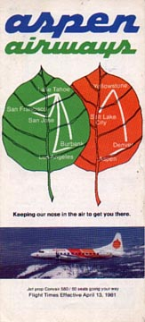
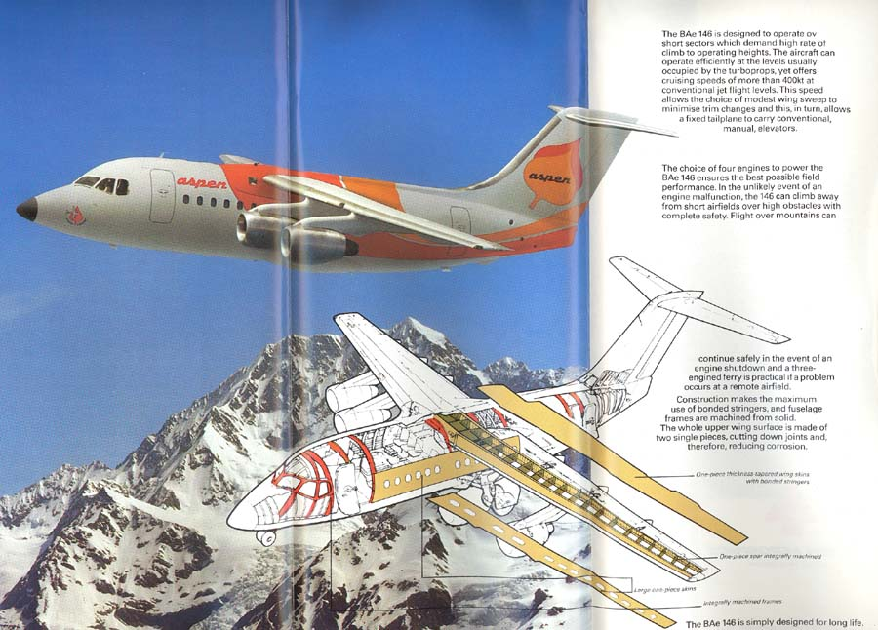
Aspen Airways
1952 - 1991
Specialized in Convair 580 service to:
Aspen
Yellowstone
South Lake Tahoe
Acquired BAE-146 jets in 1994
Became a United Express Carrier in 1985
Merged with Air Wisconsin in 1991

Slide 4
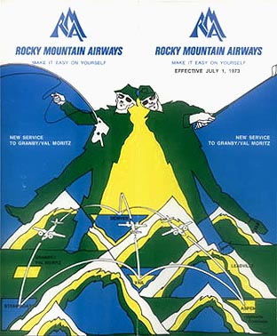
Rocky Mountain Airways
1963 - 1986
Pioneered STOL Service (Short Take-off & Landing) into:
Aspen
Vail / Avon
Steamboat Springs
Sold to Continental Express in 1986.

Slide 5
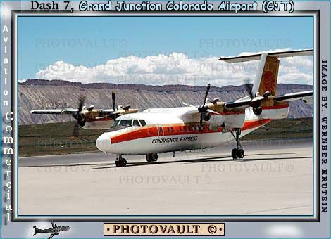
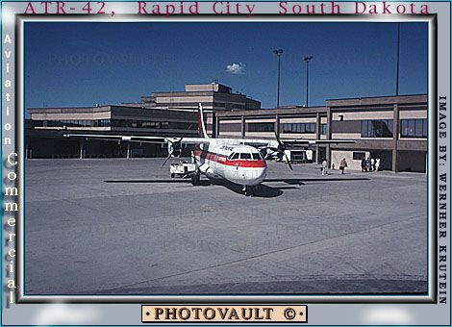
Continental Express
1986 - 1994
Extensive Regional Service from Denver Stapleton Hub to:
Aspen
Casper
Cody
Durango
Gillette
Grand Junction
Gunnison
Jackson Hole
Montrose
Pueblo
Rapid City
Riverton
Sheridan
Steamboat Springs
Telluride
Vail / Avon

Slide 6
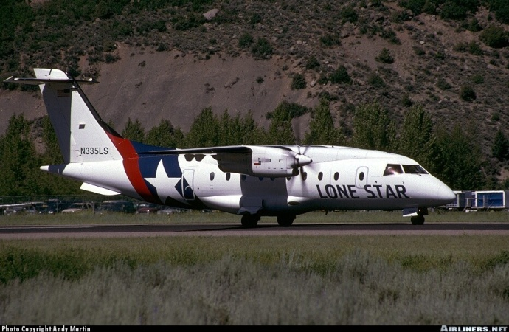
Lone Star Airlines / Aspen Mtn Air
1995 - 1998
Pioneered Long Distance Turboprop service:
DFW – Aspen/Snowmass
DFW – Santa Fe
DEN – Bozeman
Code Share Service with:
American Airlines
Frontier Airlines
Went bankrupt in 1998.

Slide 7
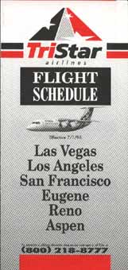
TriStar Airlines
1995 - 1997
Short-Lived BAE-146 Operator our of Las Vegas:
LAX– Aspen/Snowmass
Went bankrupt in 1997 following a
failed attempt to become a partner with Northwest Airlines as a new Airlink operator.

Slide 8
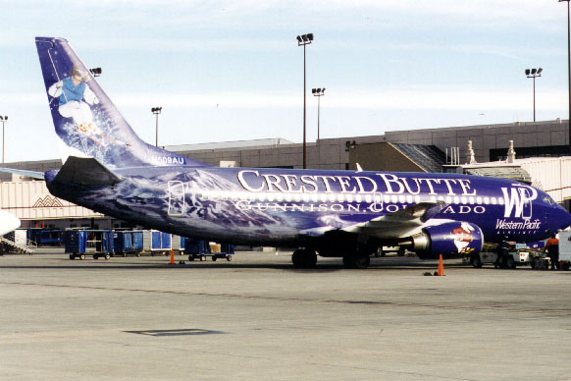

Western Pacific Airlines
1995 - 1998
737 Flying Billboards from
Colorado Springs:
Dornier 328 Service to:
Aspen / Snowmass
Durango
Gunnison
Montrose
Steamboat / Hayden
Went out of business in 1998 after a failed merger attempt with Frontier Airlines.
MAX’s assets acquired by
Air Wisconsin

Slide 9
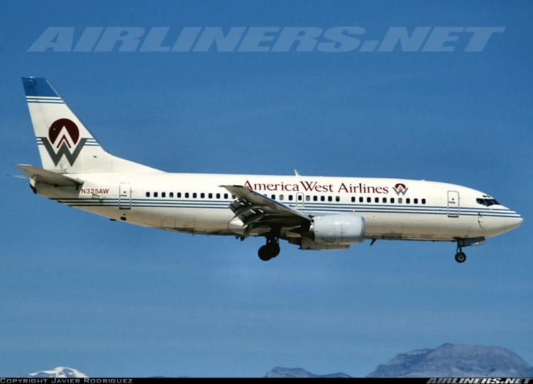
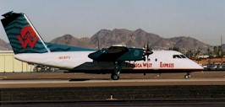
America West Airlines
1989 - 2005
737 Service from Phoenix to:
Vail / Eagle
Steamboat / Hayden
Dash-8 Service to:
Aspen / Snowmass
Durango
Grand Junction
Gunnison
Montrose
Steamboat / Hayden
Telluride
Merged with US Airways in 2005.

Slide 10
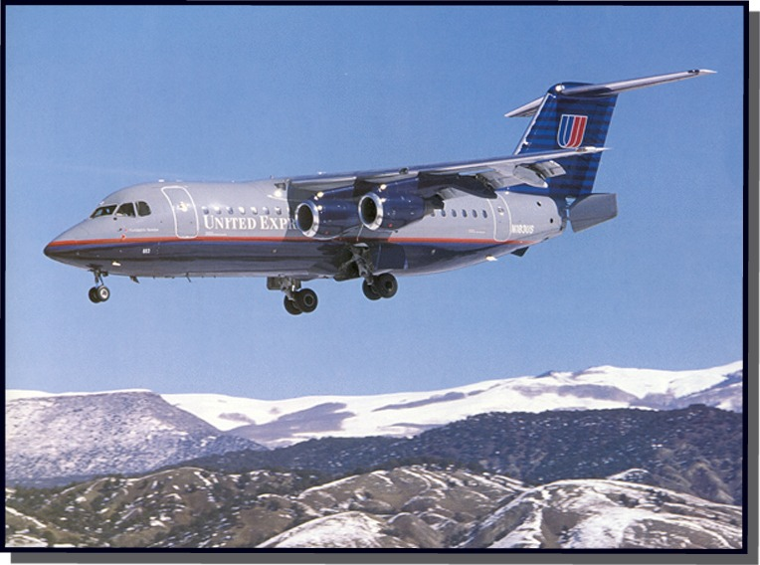
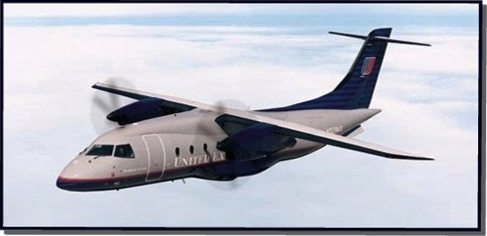
Air Wisconsin / United Express
1991 - 2006
BAE-146 Jet Service from Denver to:
Aspen / Snowmass
Vail / Eagle
Steamboat / Hayden
Jackson Hole
Dornier 328 Turboprop Service to:
Durango
Gunnison
Montrose
Jackson Hole
Steamboat / Hayden
Vail / Eagle
United Express Turbo-prop Service later replaced by Mesa’s Dash-8’s.

Slide 11




Current Major Airlines’ Hubs
American Airlines DFW, ORD, MIA
Alaska Airlines SEA, PDX
Continental Airlines IAH, CLE, EWR
Delta Air Lines ATL, SLC, CVG, JFK
Northwest MSP, DTW, MEM
Frontier Airlines: DEN
Southwest Airlines:
United Airlines DEN, LAX, SFO, ORD, IAD
US Airways PHX, LAS, CLT, PHL

Slide 12
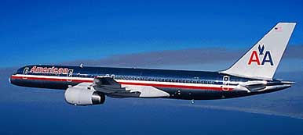
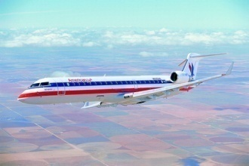
American Airlines’ Ski Routes
American Airlines’ Ski Routes
CHICAGO / OHARE
(ORD)
NEW YORK
(LGA)
NEW YORK
(JFK)
Direct Service:
Calgary / Banff
Denver
Grand Junction (began April ‘08)
Gunnison
Jackson Hole
Montrose
Reno / Tahoe
Steamboat / Hayden
Vancouver
LOS ANGELES
(LAX)
Recently Cxld:
Durango
DALLAS / FT WORTH
(DFW)
MIAMI
(MIA)

Slide 13
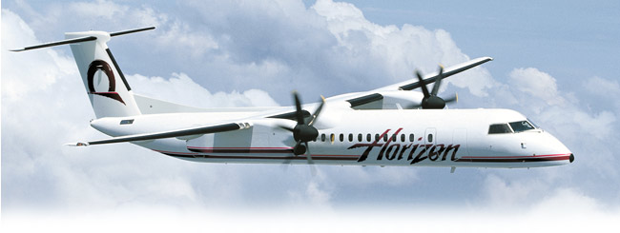
Alaska Airlines’ Ski Routes
Alaska Airlines’ Ski Routes
SEATTLE
(SEA)
PORTLAND
(PDX)
Direct Service:
Bozeman
Calgary / Banff
Denver
Kalispell
Kamloops
Kelowna
Redmond / Bend
Reno / Tahoe
Sun Valley
Vancouver
OAKLAND
(OAK)
LOS ANGELES
(LAX)

Slide 14
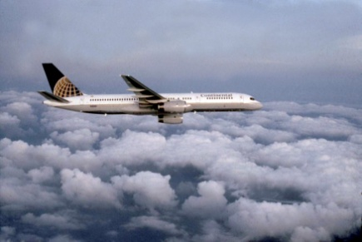
Continental Airlines’ Ski Routes
Continental Airlines’ Ski Routes
Recently Cxld:
Durango
Gunnison
Jackson Hole
LAX - Montrose
CLEVELAND
(CLE)
NEWARK
(EWR)
Direct Service:
Calgary / Banff
Denver
Montrose
Mont Tremblant
Reno / Tahoe
Salt Lake City
Steamboat / Hayden
Vail / Eagle
Vancouver
HOUSTON / BUSH
(IAH)

Slide 15
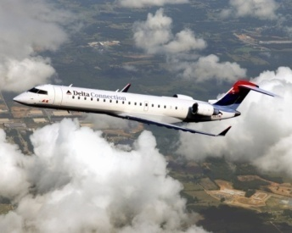
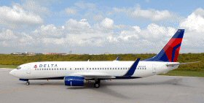
Delta Air Lines’ Ski Routes
Delta Air Lines’ Ski Routes
NY / KENNEDY
(JFK)
SALT LAKE CITY
(SLC)
NY / LAGUARDIA
(LGA)
Direct Service:
Aspen / Snowmass
Bozeman
Calgary / Banff
Durango
Grand Junction
Jackson Hole
Kalispell
Montrose
Rapid City
Redmond / Bend
Reno / Tahoe
Steamboat / Hayden
Sun Valley
Vail / Eagle
Vancouver
CINCINNATI
(CVG)
LOS ANGELES
(LAX)
ATLANTA
(ATL)

Slide 16
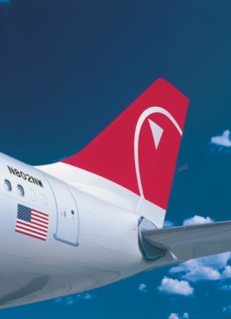
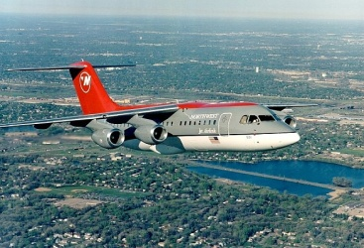
Northwest Airlines’ Ski Routes
Northwest Airlines’ Ski Routes
Recently Cxld:
Aspen / Snowmass
Jackson Hole
Reno / Tahoe
MINNEAPOLIS / ST PAUL
(MSP)
DETROIT
(DTW)
Direct Service into:
Bozeman
Calgary / Banff
Denver
Kalispell
Rapid City
Salt Lake City
Steamboat / Hayden
Vail / Eagle
Vancouver
The retirement of Mesaba’s RJ-85’s spelled the end of NW service into ASE from MSP & MEM.
MEMPHIS
(MEM)

Slide 17
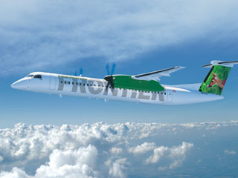
Continental Airlines’ Ski Routes
Frontier Airlines’ Ski Routes
DENVER
(DEN)

Slide 18
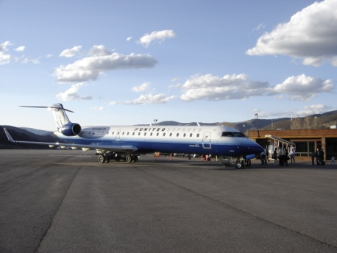
United Airlines’ Ski Routes
United Airlines’ Ski Routes
SAN FRANCISCO
(SFO)
Direct Service:
Aspen / Snowmass
Bozeman
Calgary / Banff
Durango
Grand Junction
Jackson Hole
Kalispell
Montrose
Rapid City
Reno / Tahoe
Salt Lake City
Steamboat / Hayden
Vail / Eagle
Vancouver
CHICAGO / OHARE
(ORD)
DENVER
(DEN)
LOS ANGELES
(LAX)

Slide 19

US Airways Ski Routes
US Airways’ Ski Routes
PHILADELPHIA
(PHL)
LAS VEGAS
(LAS)
Direct Service:
Aspen / Snowmass
Calgary / Banff
Denver
Durango
Grand Junction
Reno / Tahoe
Salt Lake City
Telluride
Vail / Eagle
Vancouver
CHARLOTTE
(CLT)
PHOENIX
(PHX)

Slide 20
The Future???
Carriers, Routes & Equipment
Competitive Battles Looming
  Denver Hub Supremacy (UA, F9, SW)
  AA 757’s versus UA CR7’s from Chicago?
  LA Nonstops… AA, UA, DL or Alaska?
  Frontier Regional Routes from Denver
  Jet Blue from JFK?
Right sized, more economical, high performance equipment (70-90 Seats)
  Bombardier’s Q400’s & Q400 NexGen’s
  Bombardier’s NexGen’s & C-Series Jets
  Embraer E-Jets (170’s, 175’s, 190’s)

Slide 21
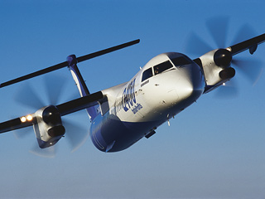
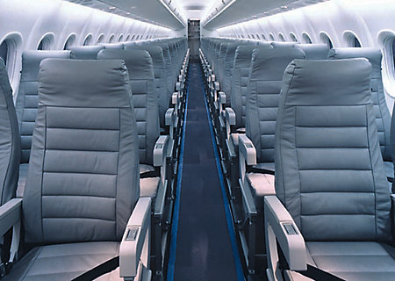
Bombardier’s Q-400
The Green Machine:
  400 MPH Cruise Speed
  More comfortable than most RJ’s
  Remarkably Low Operating Costs
  State-of-the art avionics and noise suppression technology
  Can easily fly out of ASE unrestricted
  Enormous baggage capacity
  The quietest, most fuel efficient and environmentally friendly commercial airliner ever built!
  Frontier Airlines’ Lynx subsidiary has recently launched ski resort service into Aspen, Steamboat, Durango, Grand Junction and Bozeman.

Slide 22
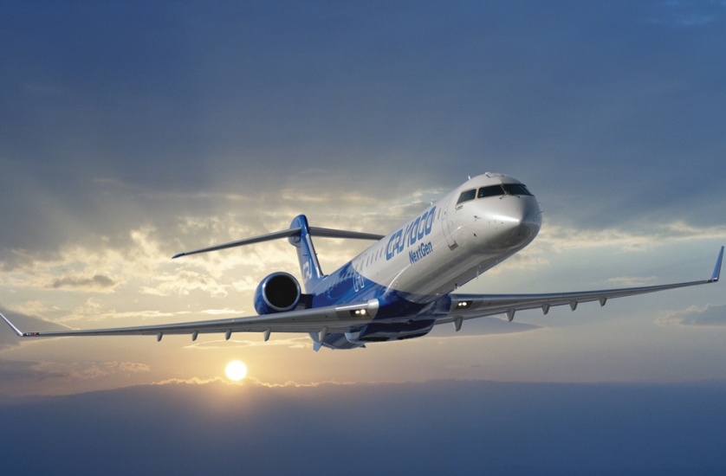
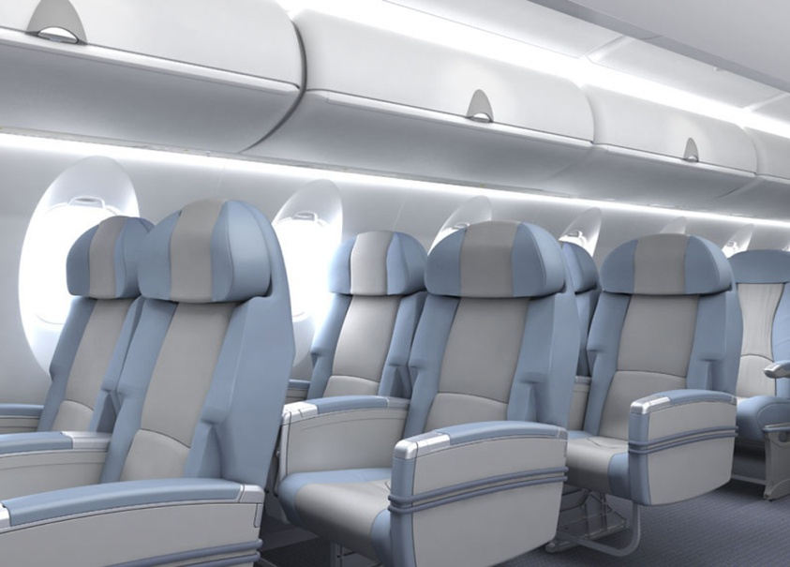
Bombardier’s CRJ NexGen’s
Redesigned Regional Jets:
Increased use of composites
More Comfortable Interiors
  Bigger Windows
  Larger Overhead Bins
More Fuel Efficient
More Environmentally Friendly
Longer Range / Higher Performance
Orders now in place with both Mesaba and SkyWest Airlines
Could be a great future fit for ski resort markets.

Slide 23
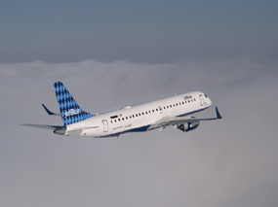
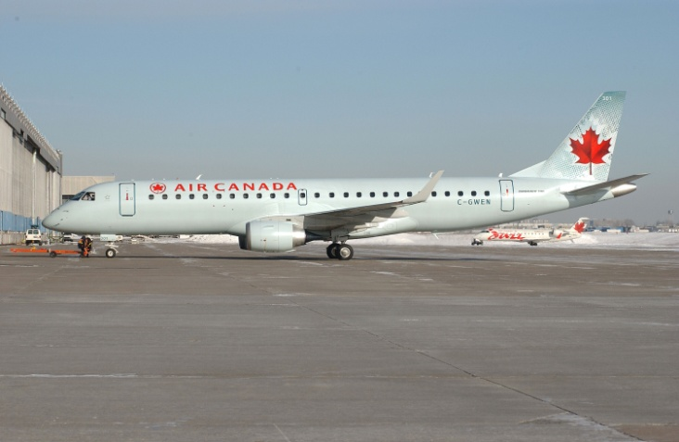
Embraer’s E-jets
Embraer 190’s:
  90 psgr EMB-190’s perhaps the perfect mountain aircraft
  Now being flown by Air Canada,
  Jet Blue and US Airways
  So far, no mountain resort air service with these new aircraft.
  Embraer 170’s & 175’s:
  70 – 76 psgr aircraft now in service with Republic and Compass for
    Delta
    Frontier
    Northwest
    United
    US Airways
  Still no mountain resort routes

Slide 24
The Future???
Airline Pricing, Extra Fees
Competition will ultimately rule
  Baggage fees are here to stay
  Premium “bundled” pricing may continue to emerge (AirFares)
  Taxes & surcharges are higher than ever and continue to grow
Fares have never been lower, but margins are tiny
  Contract bulk are not as attractive as they once were
  Airlines are yield managing flights more aggressively than ever
  Individuals will almost always find lower fares than large groups traveling together
Shipping options are worth considering

Slide 25
Closing Thought…
Long Term Pricing Trends

