Slide 1

Website Design Basics
Michael Bouton & Lennia Machen
Intermountain Ski Council

Slide 2

Getting Started
Begin with a budget. Typical web building services range from less than $5 up to $150 or more just to start. Know your budget before searching for the builder service.
Begin with research. https://www.easydns.com/10-things-to-know-before-you-register This article describes the basics you need to learn before choosing a web building package to know the ins and outs of the contract your webmaster will be signing.
Begin with the right person.
The person who takes on this job needs
to have plenty of time to devote to a
very tedious and time consuming job.
Notes:
BUDGET: Regardless of whether you are starting with a template provided by your web design company (Go Daddy, Web.com, Wix.com, etc.) The fees you will need to plan for include the cost of the “builder” as well as domain registration and WhoIs and Internic registrations. These fees can really add up if you are not choosing carefully at the outset of the project.
RESEARCH FIRST: There are a lot of pitfalls involved in choosing a company to use. Some builder services seem like a great idea at first but you later find out the site domain will not be easily identifiable. We’ve all seen site addresses that require the name of the service to be first after the www. And the name of your club site ends up being the tail end or extension after the forward slash. Determine what you wish to end up with because moving your site from one builder to another is very difficult without starting from scratch and building it all over again.
THE RIGHT PERSON: someone will be doing the work, and that person will be doing difficult and tedious work which will increase depending on the amount you pay for the web building service. The cheaper builders can be horrible to operate, or relatively easy, depending on that site building tool. Most are really great, but your research will pay off in allowing your valuable volunteer to not need to quit their day job to keep up with the club website. Seriously, this is a huge job and the webmaster will be spending many hours… consider this at the outset of the project.

Slide 3
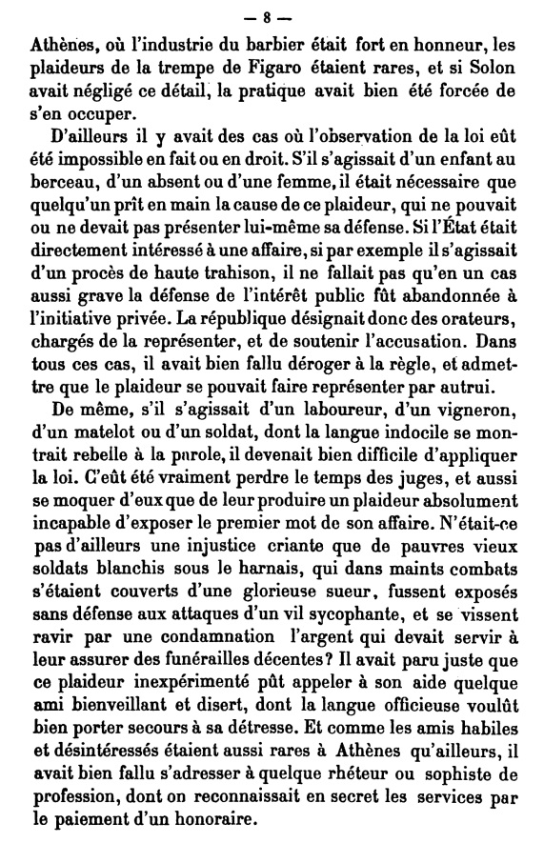
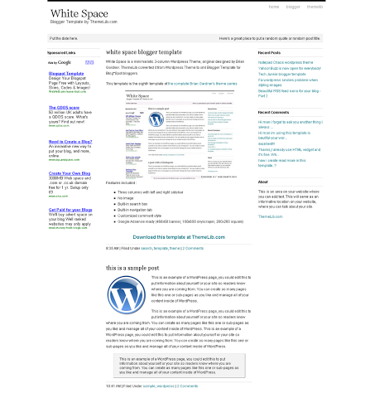
The Blank Page
All sites have two things in common: Content and white space
Notes:
CONTENT: While this sounds simple as all clubs have lots of things they wish to post, we have all seen web sites which are so packed full of content, both text and images, that there is no real white space… it’s just a solid block of text. Some advance planning of a limited amount of content in small blocks of readable text is a great idea in the early planning stages. Research other sites, find out which ones offer a relaxing experience of information presentation, images that make sense to the mission of the club or site, and a decent balance of space between blocks of text and headings.
WHITE SPACE: This is the term describing the space between the content which allows the eyes to rest and separate the content into thought, or chunks. Yes, chunks. Imagine reading a newspaper without the eye breaks created by headlines and images? Solid and continuing text can be overwhelming. Use the idea of “chunks of content” to keep text limited to smaller and more readable pieces, using the images to balance text with graphics, and the white space to create the balance and eye rests needed on the page. The best sites use white space as the guide in design… it’s that important!

Slide 4

Styles
Style Choices. Your builder will offer styles of headings, text, captions, columns, etc.
Heading One - cuteness
This is an example of the “Random” style of design. Notice that the fonts and colors make no real contribution to the graphic appeal of the page, but rather create a sense of messiness.
Heading Two – colorful!!!
And this can really be annoying when you add silly images.
Comic Sans Font
Notes:
STYLES: If you choose a site building template to build your site, which is highly recommended, this huge task of choosing styles is taken care of by the designers of the template. They will make the choices of fonts, sizes, and color for you. This is a very good thing. We have all seen sites where the design seems to be “Random.” … not a good thing. We might see 3-4 colors used, a variety of sizes of headings, and random use of some plain fonts mixed with curly cues or the dreaded Comic Sans.
WHITE SPACE: This is the space between the content which allows the eyes to rest and separate the content into thought – chunks. Yes, chunks. Imagine reading a newspaper without the eye breaks created by headlines and images? Solid and continuing text can be overwhelming. Use the idea of chunks of content to keep text limited to smaller pieces, the images to balance text with graphics, and the white space to create the balance and eye rests into the page. The best sites use white space as the guide in design… it’s that important!

Slide 5
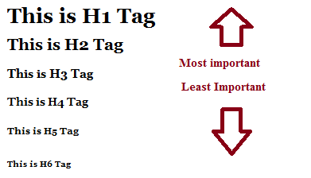
Style choices have purpose
Style choices are valuable so sight impaired readers may use page reading software.
Heading 1
Heading 3
Paragraph text which
can be used in italics,
bold, underlined, etc.
Notes:
STYLES: “Styles” is based on the design theory of cascading style sheets which offer set HTML heading tag sizes from one to six in size, and specific font styles and colors which screen reading software can recognize. The screen reading software searches and finds the headings versus paragraphs, allowing the user the choice to search for headings or stop and read the content. Vital to those without sight.
Again, this is another area where a web building template can cut through the difficult to choose and code, and offer the webmaster only those choices which will be beneficial.

Slide 6
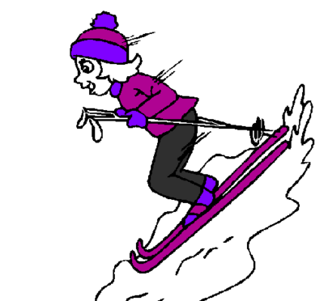
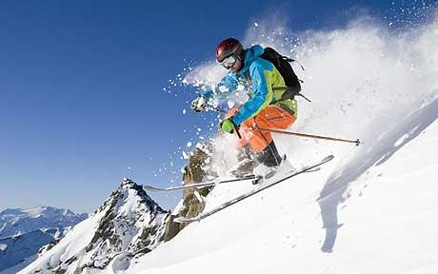
Images and Photos
Images and photos can be one of the most important features of your page visual appeal, use them wisely
Notes:
IMAGES: Which one makes you want to go skiing? With all the easily available free clip art, there really is no excuse to use the old fashioned clip art when you can insert a photo taken during one of your latest trips, or a clip art photo that will enhance your content and match your story. Use them wisely. Only use the most important, and limit them to only a few per page, or one per every 2-3 paragraphs.
Choose to text wrap your photos so the text will border your photo and create a nice visual framing with the story. In a web builder site this will be an easy selection. Beware to also use your white space to keep from crowding the frame of the image. You may need to select the size of white space or “padding” you need, try 1 or 2 points. Also make a point to caption all images, especially if they are of club events or people. If you are using clip art for decoration it may not be needed.
Another item on images and photos; you will be offered the chance to enter “alternative text” or “Alt text” for your photo. Always fill this in with a description of the photo so those with sight disabilities may read a description. “A man skiing” is not going to cut it…. “a man taking air as he skis off the top of a steep ridge with powder snow flying around him”… is better.
Another note on images… stay away from the animated cartoon like images. They’re just annoying and makes the reader want to leave your page while the cute little skier blinks and repeats over and over and over… not good design, only appropriate for little kids and images of cute puppies. The use of rolling banners, rolling photos, and other things that move, should be used judiciously. One per page is usually enough. Rolling photos, where there may be 3-4 photos that change on rotation, may be really great for displaying important member trip photos, or other anouncement items, but should be limited to the front page.

Slide 7
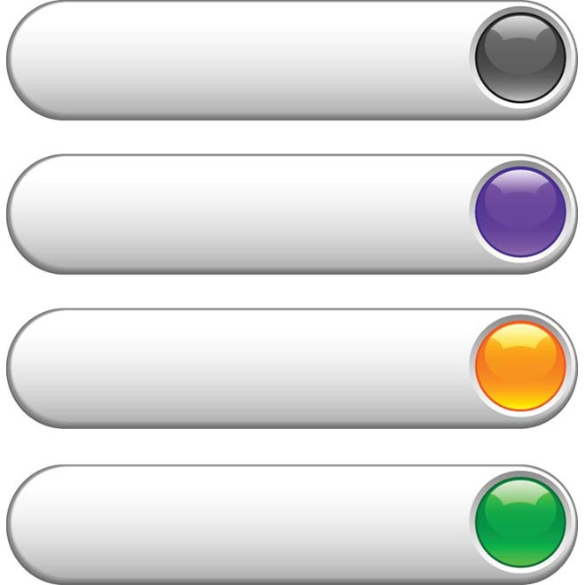
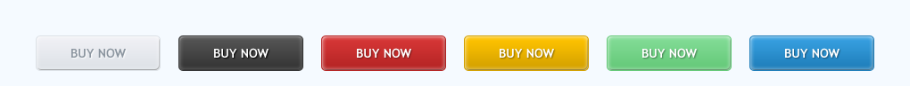
Navigation
Menu buttons are vital, plan them well
  Vertical versus horizontal, one word or two
  Use only keywords with meaning
  Keep the number of pages to a minimum
  Use sub-categories
  Leave bread crumbs and return
  keys
  ALWAYS choose to open a new
  page for all links.
Notes:
BUTTONS:
The eye can do either vertical or horizontal well, consider the design you may need for mobile sites, and this will likely be vertical.
Use no more than one or two words so the button length stays trim and simple to understand. Use words that will be normally used like “News” or “About” meaning a page about the club, or “Membership” to indicate the obvious. Only use unique headings if appropriate and easily understood to your readers.
Most site builder packages offer 5-6 pages in a basic package. If you want a larger site, this is fine, but plan well so the reader doesn’t get lost in the breadth of the site. Nest sub-categories into parent pages so they will be easily found by mouse-over and drop down menus. Consider how this will transfer over to a mobile site and how it will look on a phone sized screen.
Bread crumbs… this is actually a technical term to describe the use of a way to return to a page. In the old days there were page heading words left at the top of the page which would work as links so the reader could click one and return home. Bread crumbs… get it? Now we can use the back button to move back a page at a time. By setting up your page so the menu shows at the top or side, you are creating this theory of providing a why back. This sounds simple, but it has to be considered as we all have encountered the site which opens a whole new open page with the click of each sub category, ending up with all the pages open in all 8-10 windows. Then to leave the site, you are clicking closed on all of them one at a time. Hopefully your web builder will not allow this, but the webmaster may select to open a new page when they link a new page.
When to “open a new page” is very appropriate whenever you place a link to another site or a document. For example, if you place a membership form on your site, select to open a new page. Then the reader is able to leave it open, work on it later, print, etc., without losing their place on your site. They can also use this when there is a link to another site, like the National Ski Federation site… it’s nice to offer the link, but you want your reader to still come back to your site.
Colors… here are samples of buttons with random color use. Hopefully your template will guide your webmaster to the coordinated colors appropriate for your site look.

Slide 8
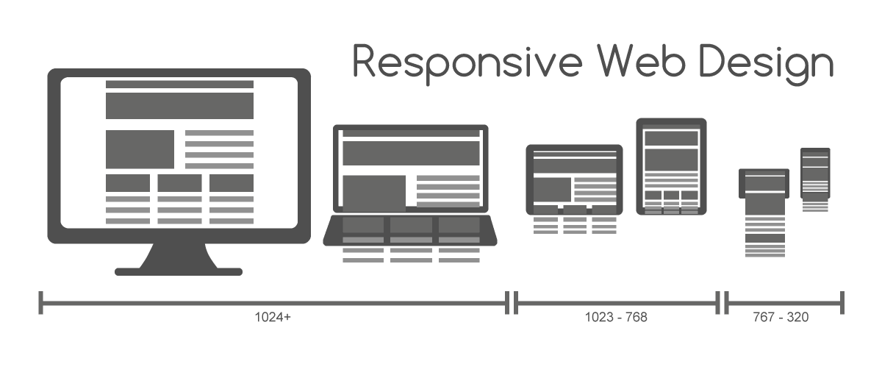
Page Width and Columns
Choose by purpose
  The human eye can read 7 to 11 words per line comfortably.
  Do not center text unless it is a short phrase and you wish to bring attention to it… not for use with longer text.
  Width; 800 pixels is an average screen, but consider allowing the template to give you the width so it can be flexible to the reader. Often the template will provide a choice of column and text box size. Choose the least cluttered.
Notes:
WIDTH:
This is another area where the template can guide the webmaster through the tricks of page design. No one wants to plan out a page which causes the reader to use the scroll bar at the bottom of the page, so to avoid this, use a template which will manage the column width and page width for you. They will likely also adjust for mobile site size and shape.
TEXT CENTERING: Very old school… only useful to draw attention to your club motto or a short quote. The human eye simply likes to start on the left and read to the right. The width of the lines of text can be chosen to be ragged edge (like is shown on this slide), allowing a natural edge of text to happen as the words reach the edge of the column, or justified, which is like in a newspaper where both the left and right margins are straight…. Like in this graphic of a page design.
RESOLUTION: Another old school worry as the history on this is long and varied. Today the resolution is generally set to 1366x768 for today’s screens. Let the template work this through unless you are making your own site through a program like Dreamweaver. The resolution and size of photos, column width, etc., are all very advanced skills, and the templates and builders have come a LONG way towards making this tedious task easy.
COLUMNS: This is a personal choice and one made best by searching for other sites which appear easy to read and offer plenty of white space. Some sites appear too cluttered, while others are almost too bland. It comes back to the amount of content, the number of pages you want, and how much information you need to post on the site.
MAKE A MOCK-UP: either draw out your ideas or save addresses to sites you like, compile the pros and cons, and determine what you wish. Most builder sites offer many choices in this area.

Slide 9
Some Examples
  FWSA http://www.fwsa.org/ Note the use of color, the appropriate images, and headings. This unique design by Catherine Ohl, is a very professional example of a visually good site which offers lots of content and is easy to use.
  Intermountain Ski Council http://www.intermountainskicouncil.org/ Our site was built using a web builder on Go Daddy. The template had different photos in the heading and we inserted our own as needed.
  Fresno Ski Club http://fresnoskiclub.com/ Crissymarie King has designed a very nice club site which offers all the information with attractive photos and member interest points.
  Snowchasers http://snowchasers.org/ Steve Rhodes offers another example of a highly useful site with great use of color and white space. He has inserted a couple of rolling images that are attractive and show club interests.
Notes:
WIDTH:
This is another area where the template can guide the webmaster through the tricks of page design. No one wants to plan out a page which causes the reader to use the scroll bar at the bottom of the page, so to avoid this, use a template which will manage the column width and page width for you. They will likely also adjust for mobile use.
TEXT CENTERING: Very old school… only useful to draw attention to your club motto or a short quote. The human eye simply likes to start on the left and read to the right. The width of the lines of text can be chosen to be ragged edge, allowing a natural edge of text to happen as the words reach the edge of the column, or justified, which is like in a newspaper where both the right and left margins are straight…. Like in this graphic.
RESOLUTION: Another old school worry as the history on this is long and varied. Today the resolution is generally set to 1366x768 for today’s screens. Let the template work this through unless you are making your own site through a program like Dreamweaver. The resolution and size of photos, column width, etc., are all very advanced skills, and the templates and builders have come a LONG way towards making this tedious task easy.
COLUMNS: This is a personal choice and one made best by searching for other sites which appear easy to read and offer plenty of white space. Some sites appear too cluttered, while others are almost too bland. It comes back to the amount of content, the number of pages you want, and how much information you need to post on the site.
MAKE A MOCK-UP: either draw out your ideas or save addresses to sites you like, compile the pros and cons, and determine what you wish. Most builder sites offer many choices in this area.

Slide 10
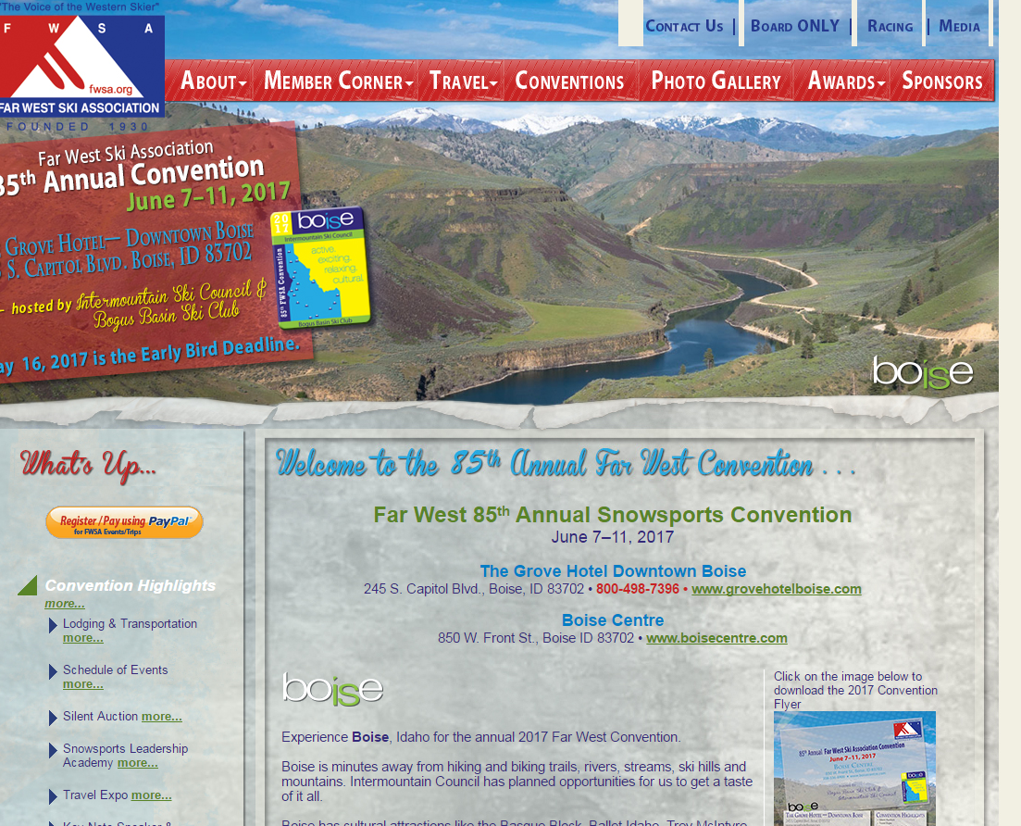
Another Example
Notes:
This is a screen shot of the 2017 Boise Convention announcement on the Far West Site. Notice below the red navigation buttons, Catherine has placed a full width photo of nearby Snake River Canyon to show the wide open Boise terrain and to provide a backdrop for what the attendees might see in June.
She has used a layer effect to place the box with the “Who-What-Where-When” info over the backdrop, and placed it at an angle to further draw attention to the vital information.
Then, you can see the easy links on the left column, offering the reader the easy way to click to register. Notice she uses the PayPal method, and has found a clip art “PayPal” button to make the sign up easy for the reader.
Then, notice the list under the paypal button, of items important within the convention itinerary, and all the links within that list that will fill in all the details. She has chosen specific colors for the links on the page, specific colors for the headings, all to match the “BoISe” logo.
The layout is pleasing, and highly useful by design, offers the reader a way to understand the point – to learn about the convention, register, as well as a way to print out a few items to take to their ski club meetings. FWSA member clubs could simply post this address on their own sites to lead members towards attending the Boise convention.

Slide 11
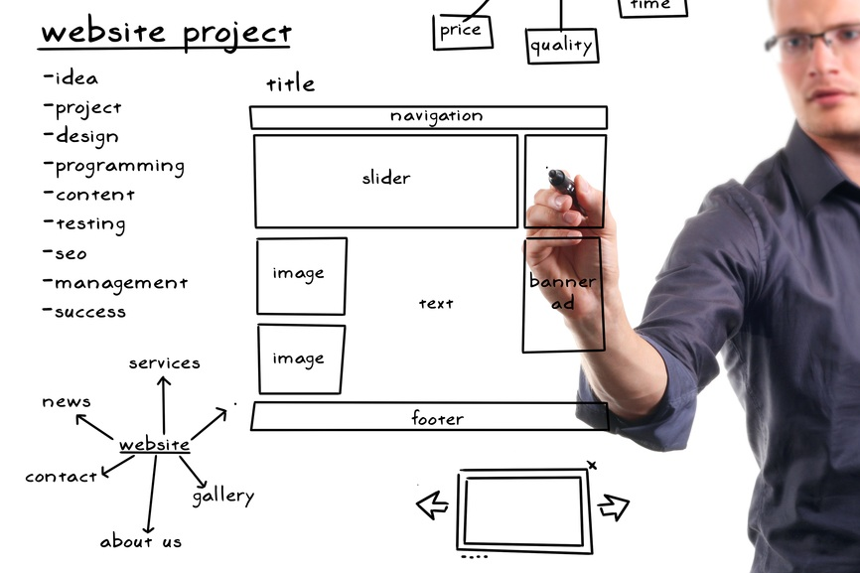

Questions?
Thank you for your attendance and attention

